Slide 1

Hibernate One-to-One

Slide 2


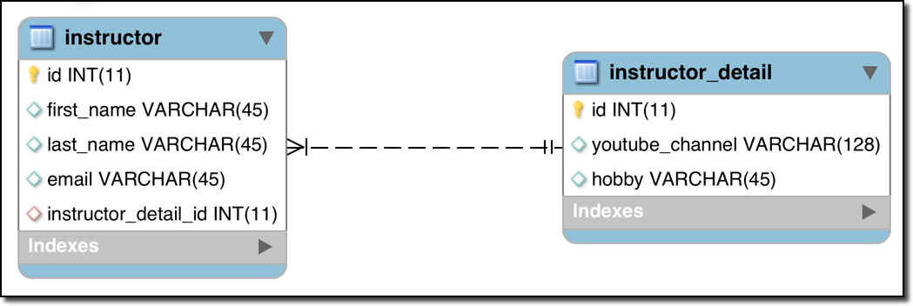
One-to-One Mapping
An instructor can have an “instructor detail” entity
Similar to an “instructor profile”
Instructor Detail
Instructor
www.luv2code.com

Slide 3


Uni-Directional
Instructor Detail
Instructor
www.luv2code.com

Slide 4
Development Process: One-to-One
Step-By-Step
Prep Work - Define database tables
Create InstructorDetail class
Create Instructor class
Create Main App
www.luv2code.com

Slide 5

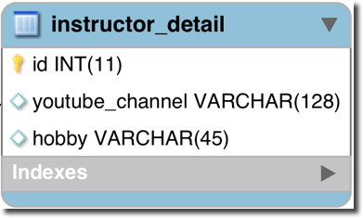
table: instructor_detail
File: create-db.sql
CREATE TABLE `instructor_detail` (
`id` int(11) NOT NULL AUTO_INCREMENT,
`youtube_channel` varchar(128) DEFAULT NULL,
`hobby` varchar(45) DEFAULT NULL,
PRIMARY KEY (`id`)
);
...
www.luv2code.com

Slide 6

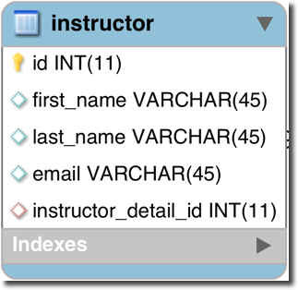
table: instructor
File: create-db.sql
…
CREATE TABLE `instructor` (
`id` int(11) NOT NULL AUTO_INCREMENT,
`first_name` varchar(45) DEFAULT NULL,
`last_name` varchar(45) DEFAULT NULL,
`email` varchar(45) DEFAULT NULL,
`instructor_detail_id` int(11) DEFAULT NULL,
PRIMARY KEY (`id`)
...
);
www.luv2code.com

Slide 7
Foreign Key
Link tables together
A field in one table that refers to primary key in another table
www.luv2code.com

Slide 8

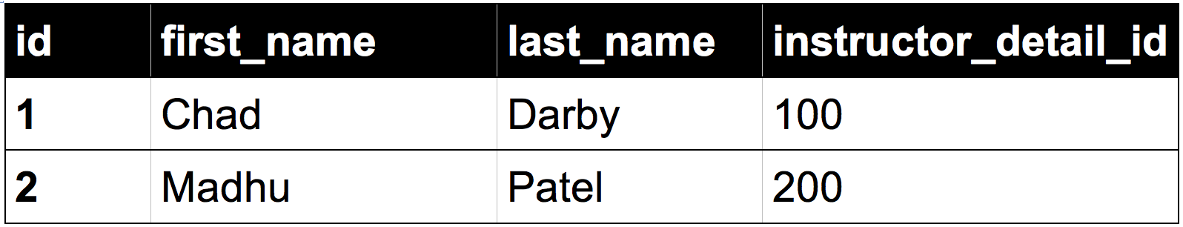
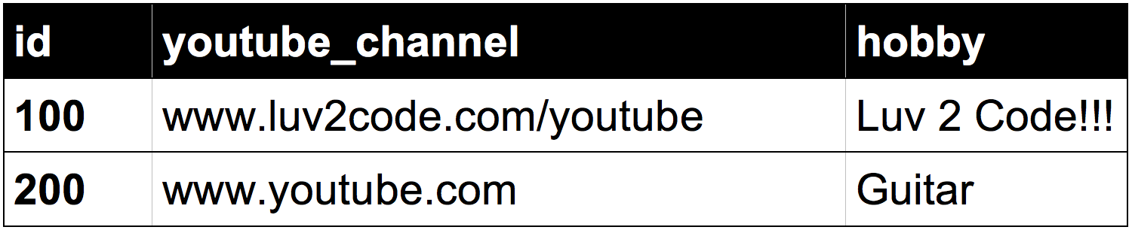

Foreign Key Example
Foreign key column
Table: instructor
Table: instructor_detail
www.luv2code.com

Slide 9



Defining Foreign Key
File: create-db.sql
…
CREATE TABLE `instructor` (
…
CONSTRAINT `FK_DETAIL` FOREIGN KEY (`instructor_detail_id`) REFERENCES `instructor_detail` (`id`)
);
www.luv2code.com

Slide 10
More on Foreign Key
Main purpose is to preserve relationship between tables
Referential Integrity
•
Prevents operations that would destroy relationship
•
Ensures only valid data is inserted into the foreign key column
•
Can only contain valid reference to primary key in other table
www.luv2code.com

Slide 11
Development Process: One-to-One
Step-By-Step
Prep Work - Define database tables
Create InstructorDetail class
Create Instructor class
Create Main App
www.luv2code.com

Slide 12


Step 2: Create InstructorDetail class
@Entity @Table(name="instructor_detail") public class InstructorDetail {
@Id @GeneratedValue(strategy=GenerationType.IDENTITY) @Column(name="id")
private int id;
@Column(name="youtube_channel") private String youtubeChannel;
@Column(name="hobby") private String hobby;
// constructors
// getters / setters
}
www.luv2code.com

Slide 13


Step 3: Create Instructor class
@Entity @Table(name="instructor") public class Instructor {
@Id @GeneratedValue(strategy=GenerationType.IDENTITY) @Column(name="id")
private int id;
@Column(name="first_name") private String firstName;
@Column(name="last_name") private String lastName;
@Column(name="email") private String email;
…
// constructors, getters / setters
}
www.luv2code.com

Slide 14


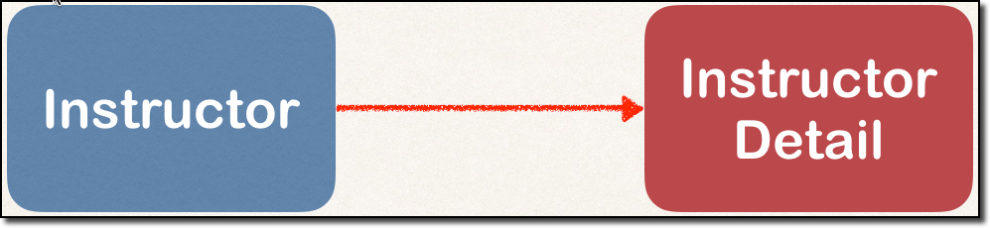
Step 3: Create Instructor class - @OneToOne
@Entity @Table(name="instructor") public class Instructor {
…
@OneToOne @JoinColumn(name=“instructor_detail_id") private InstructorDetail instructorDetail;
…
// constructors, getters / setters
}
www.luv2code.com

Slide 15
Entity Lifecycle
Operations | Description
Detach | If entity is detached, it is not associated with a Hibernate session
Merge | If instance is detached from session, then merge will reattach to session
Persist | Transitions new instances to managed state. Next flush / commit will save in db.
Remove | Transitions managed entity to be removed. Next flush / commit will delete from db.
Refresh | Reload / synch object with data from db. Prevents stale data
www.luv2code.com

Slide 16








Entity Lifecycle - session method calls
New / Transient
commit
save / persist
rollback / new
delete / remove
Persistent / Managed
refresh
Removed
persist/rollback
commit/rollback/close
merge
rollback
Detached
www.luv2code.com

Slide 17



Cascade
Recall: You can cascade operations
•
Apply the same operation to related entities
Instructor Detail
Instructor
save
www.luv2code.com

Slide 18







Cascade Delete
Foreign key column
Table: instructor
Table: instructor_detail
www.luv2code.com

Slide 19
@OneToOne - Cascade Types
Cascade Type | Description
PERSIST | If entity is persisted / saved, related entity will also be persisted
REMOVE | If entity is removed / deleted, related entity will also be deleted
REFRESH | If entity is refreshed, related entity will also be refreshed
DETACH | If entity is detached (not associated w/ session), then related entity will also be detached
MERGE | If entity is merged, then related entity will also be merged
ALL | All of above cascade types
www.luv2code.com

Slide 20



Configure Cascade Type
@Entity @Table(name="instructor") public class Instructor {
…
@OneToOne(cascade=CascadeType.ALL) @JoinColumn(name="instructor_detail_id") private InstructorDetail instructorDetail;
…
// constructors, getters / setters
}
By default, no operations are cascaded.
www.luv2code.com

Slide 21

Configure Multiple Cascade Types
@OneToOne(cascade={CascadeType.DETACH, CascadeType.MERGE, CascadeType.PERSIST, CascadeType.REFRESH, CascadeType.REMOVE})
www.luv2code.com

Slide 22

Step 4: Create Main App
public static void main(String[] args) {
…
// create the objects
Instructor tempInstructor = new Instructor("Chad", "Darby", "darby@luv2code.com");
InstructorDetail tempInstructorDetail =
new InstructorDetail(“http://www.luv2code.com/youtube", "Luv 2 code!!!");
…
}
www.luv2code.com

Slide 23


Step 4: Create Main App
public static void main(String[] args) {
…
// create the objects
Instructor tempInstructor = new Instructor("Chad", "Darby", "darby@luv2code.com");
InstructorDetail tempInstructorDetail =
new InstructorDetail(“http://www.luv2code.com/youtube", "Luv 2 code!!!");
// associate the objects tempInstructor.setInstructorDetail(tempInstructorDetail);
// start a transaction session.beginTransaction();
Instructor
Instructor
session.save(tempInstructor);
Detail
// commit transaction session.getTransaction().commit();
…
save
}
www.luv2code.com

